Slide 1
Social Connect & Responsibility BSCK307
Presented by
Sandesh
4VP22CS085

Slide 2
Contents:
MODULE 1: Plantation and adoption of a tree
MODULE 2: Heritage walk & Craft corner
MODULE 3: Organic farming and waste management
MODULE 4: Water Conservation

Slide 3
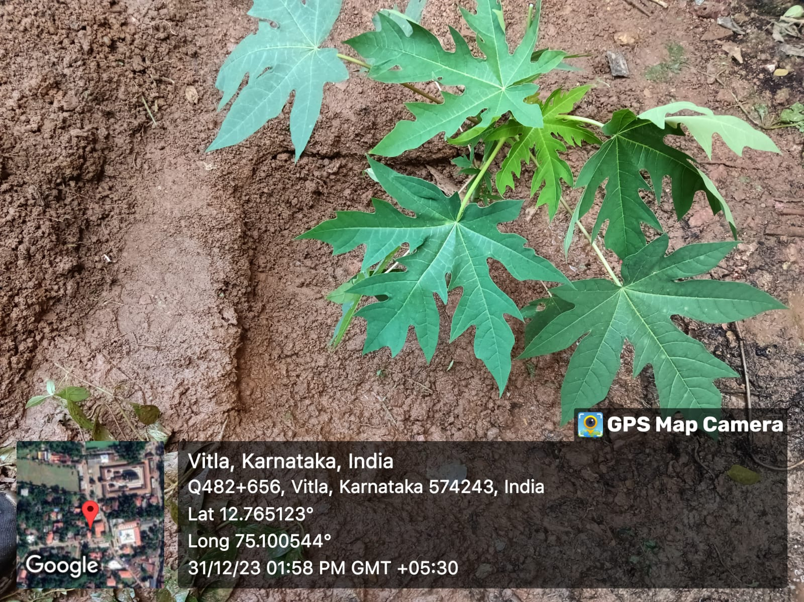
1.Plantation and adoption of a tree
Papaya tree:
Scientifically known as Carica papaya and it belongs to the family Caricaceae.It is rich in vitamin C and also detoxes the body which is good for reducing skin related problems and helps in repairing of skin cells.
How to plant:
Choose a proper location. Dug a hole of ½ meter spacing. Place the tree sample in the middle of the pit after cover up the hole.
Why: It is easily available . Papaya tree can grow within 7-8 months and the fruits will be ready for harvesting in 10-11 months from planting.

Slide 4
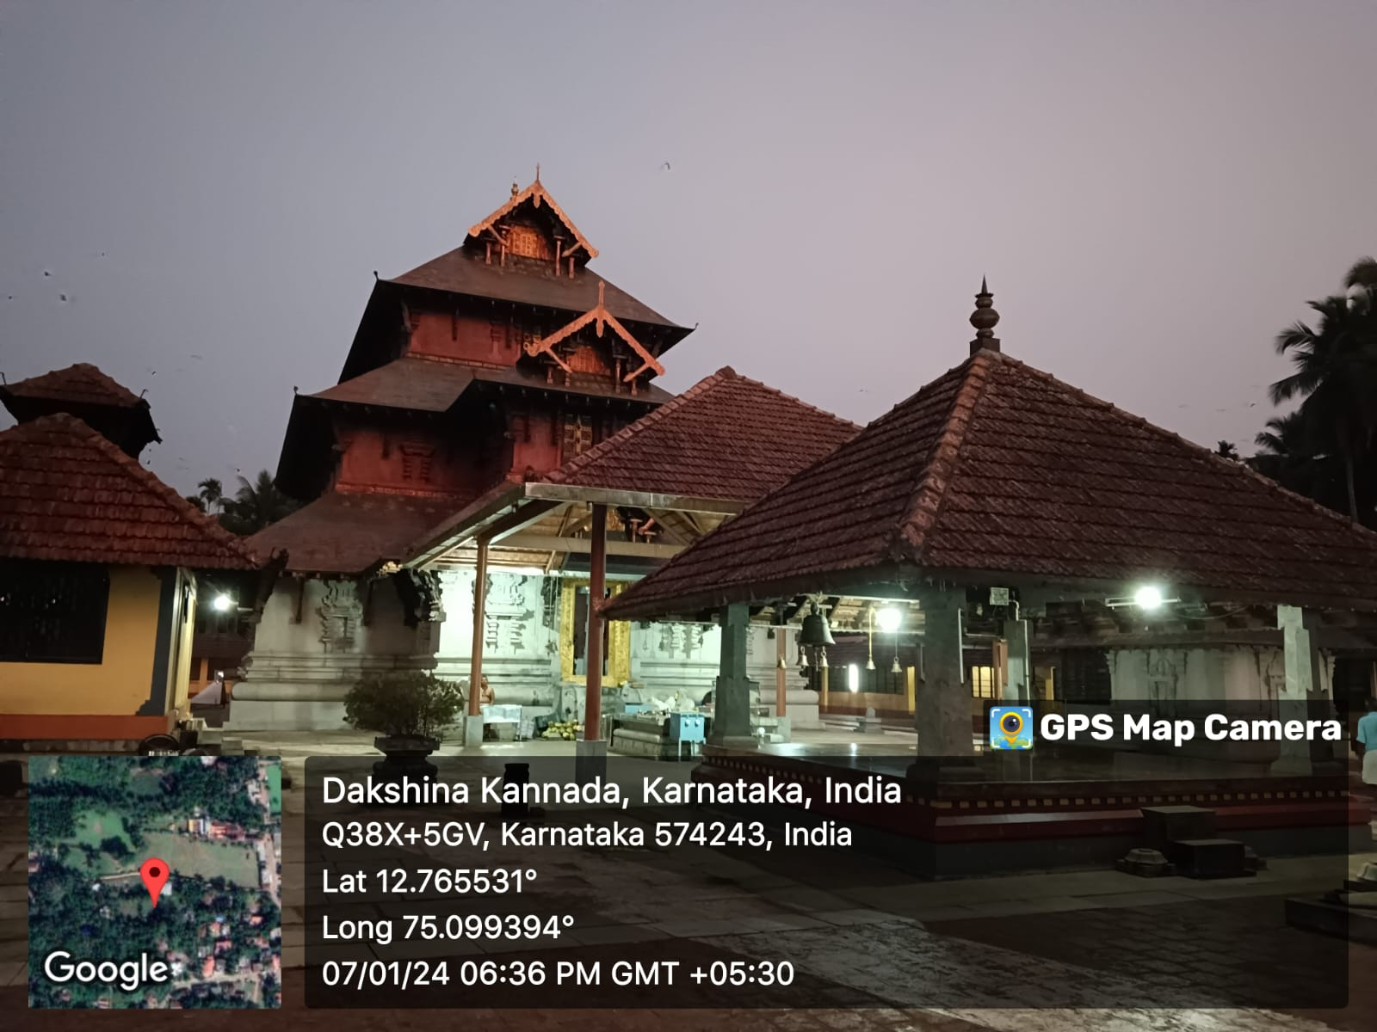
2.Heritage walk and crafts corner
Shree Punchalingeshwara Temple :
History:
“Pancha” means five. As per the name suggests there are five linga’s in the temple.Those five linga’s are: Vamadeva,Thatpurusha, Aghora, Sadyojatha and Ishana.
According to the local mythology it is said that the temple is related with Pancha Pandavas and they are the once who place these five linga’s for their worship during their vanavas.
The temple is currently under the rule of Vitla Seema Arasu family that is Dombahegade royal family.

Slide 5
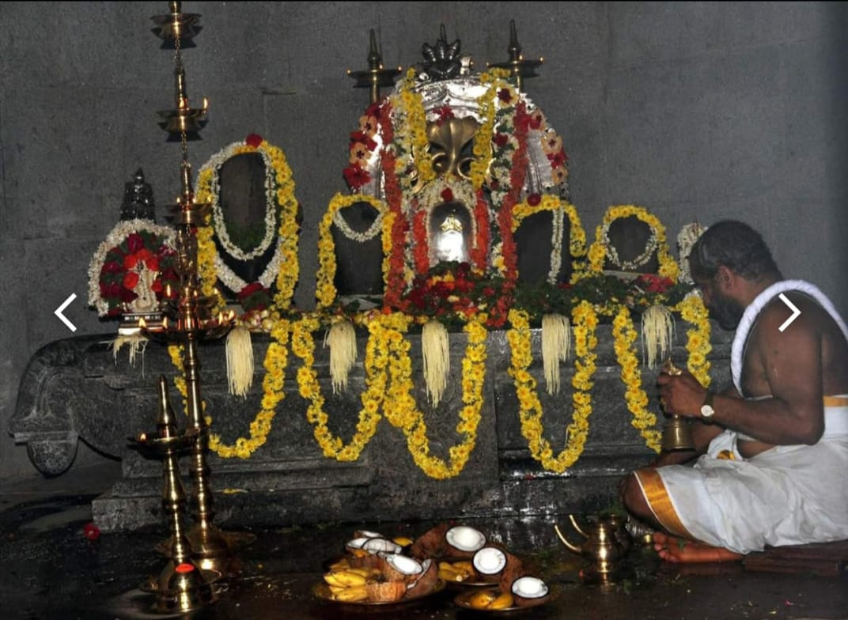
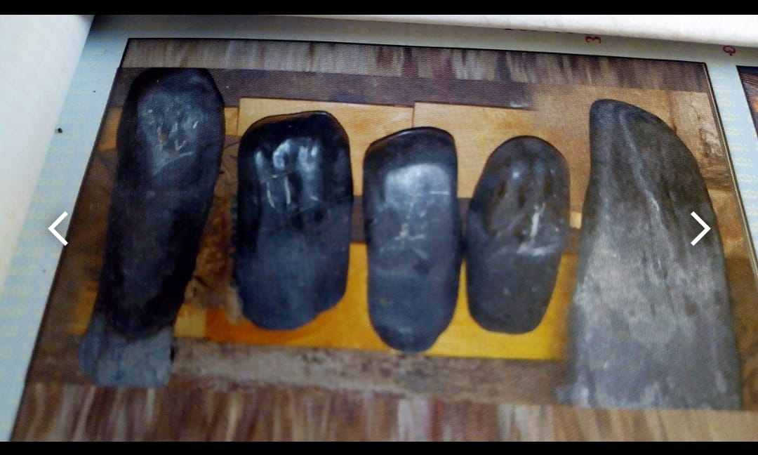
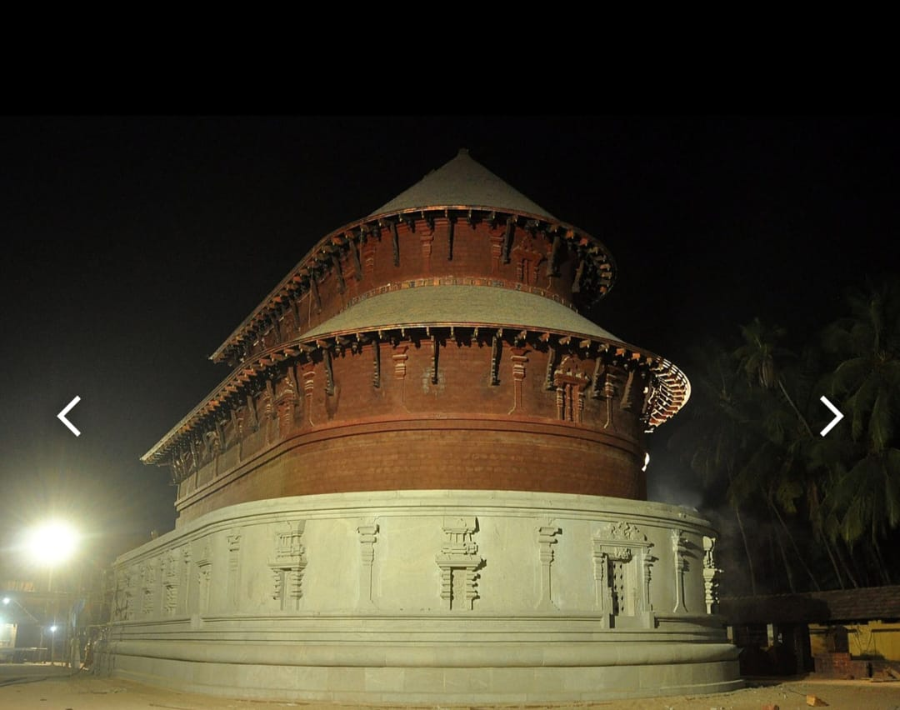

Slide 6
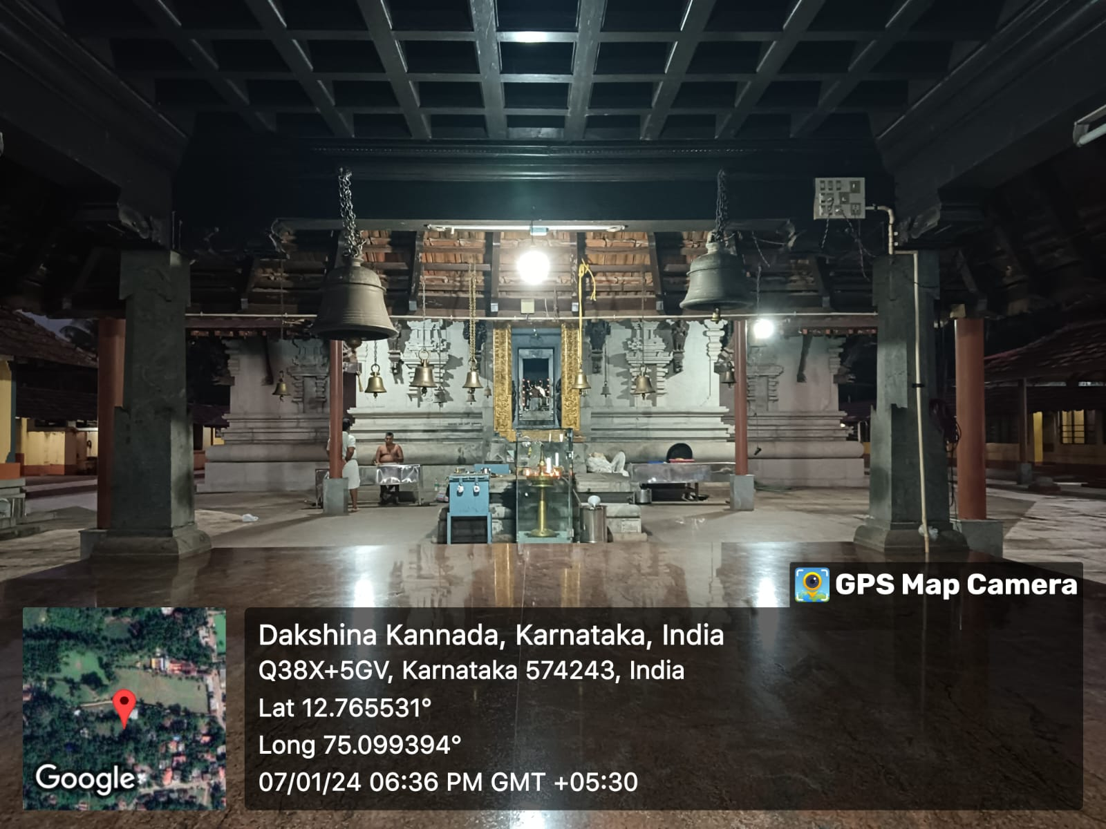
Architecture:
Shree Punchalingeshwara temple is having a special architecture known as “Gaja Prusta”, that is it looks like the back of an elephant.
Major pooja events:
*Lakshadeepotsava
*Dhanu pooja
*Navarathri pooja
*Maharathotsava

Slide 7
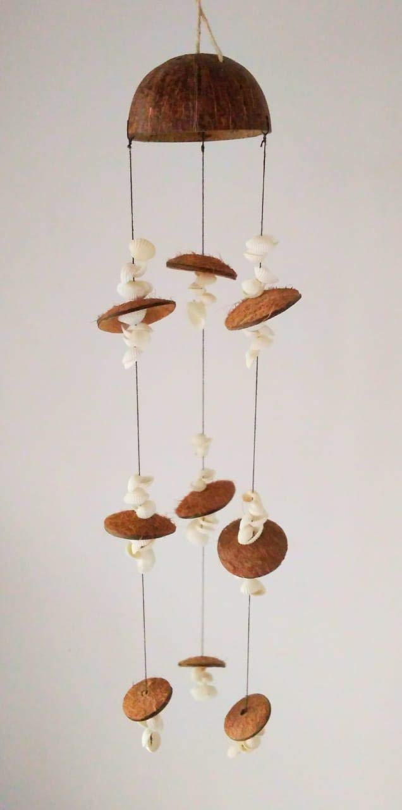
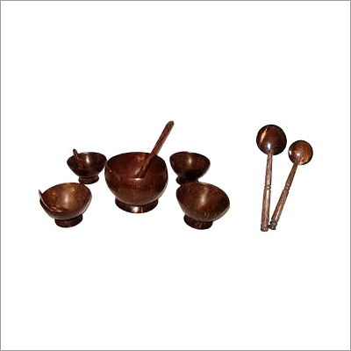

Craft Corner:
Waste coconut shell:
After the usage coconut, the shells can be reused for various purpose
like for kitchen appliances and for the decoration purposes. The shells are cleaned and polished using sand paper and used to make eco-friendly appliances

Slide 8
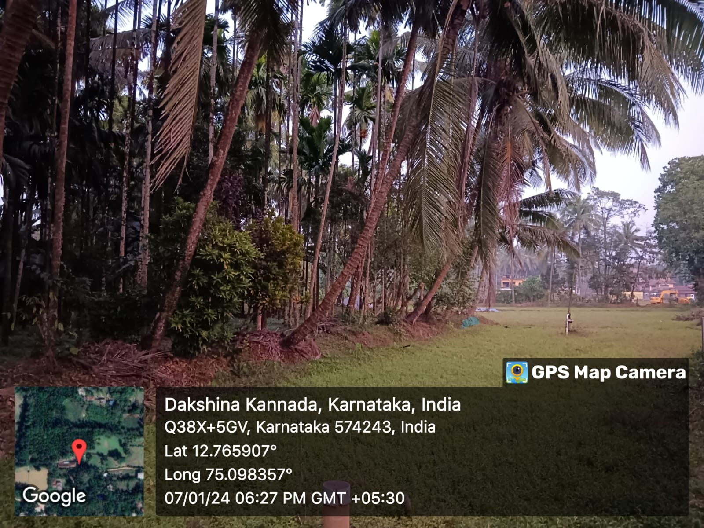
3.Organic farming and waste management:
For the farming and waste management , I visited a local farmer who grows rice crops, coconut and areca nut, banana tree and some of the vegetable like eggplant, lady’s finger and spinach.
They the also have cow farming. The edible waste like grass and all are fed to the cows. And the animal waste that is cow dung produced are then mixed with soil and other farming waste to get composed cow manure which are then used for plants and veggies which acts as a natural fertiliser which provides nutrients and minerals to the crops without adding any harmful effects to the plants

Slide 9
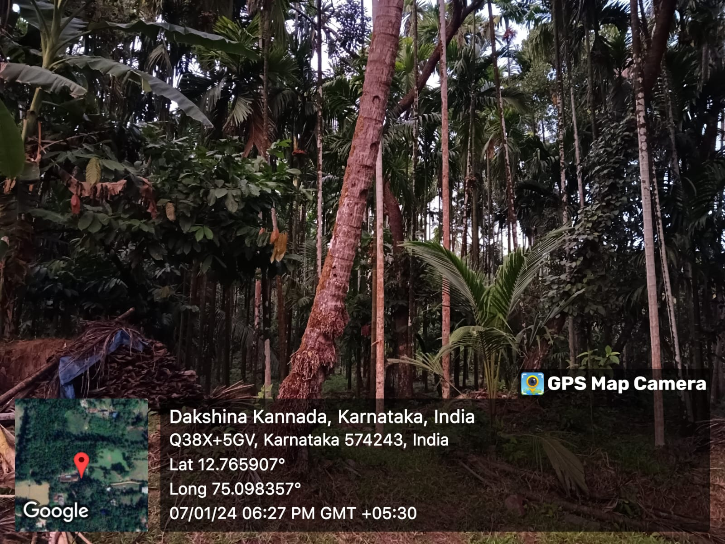
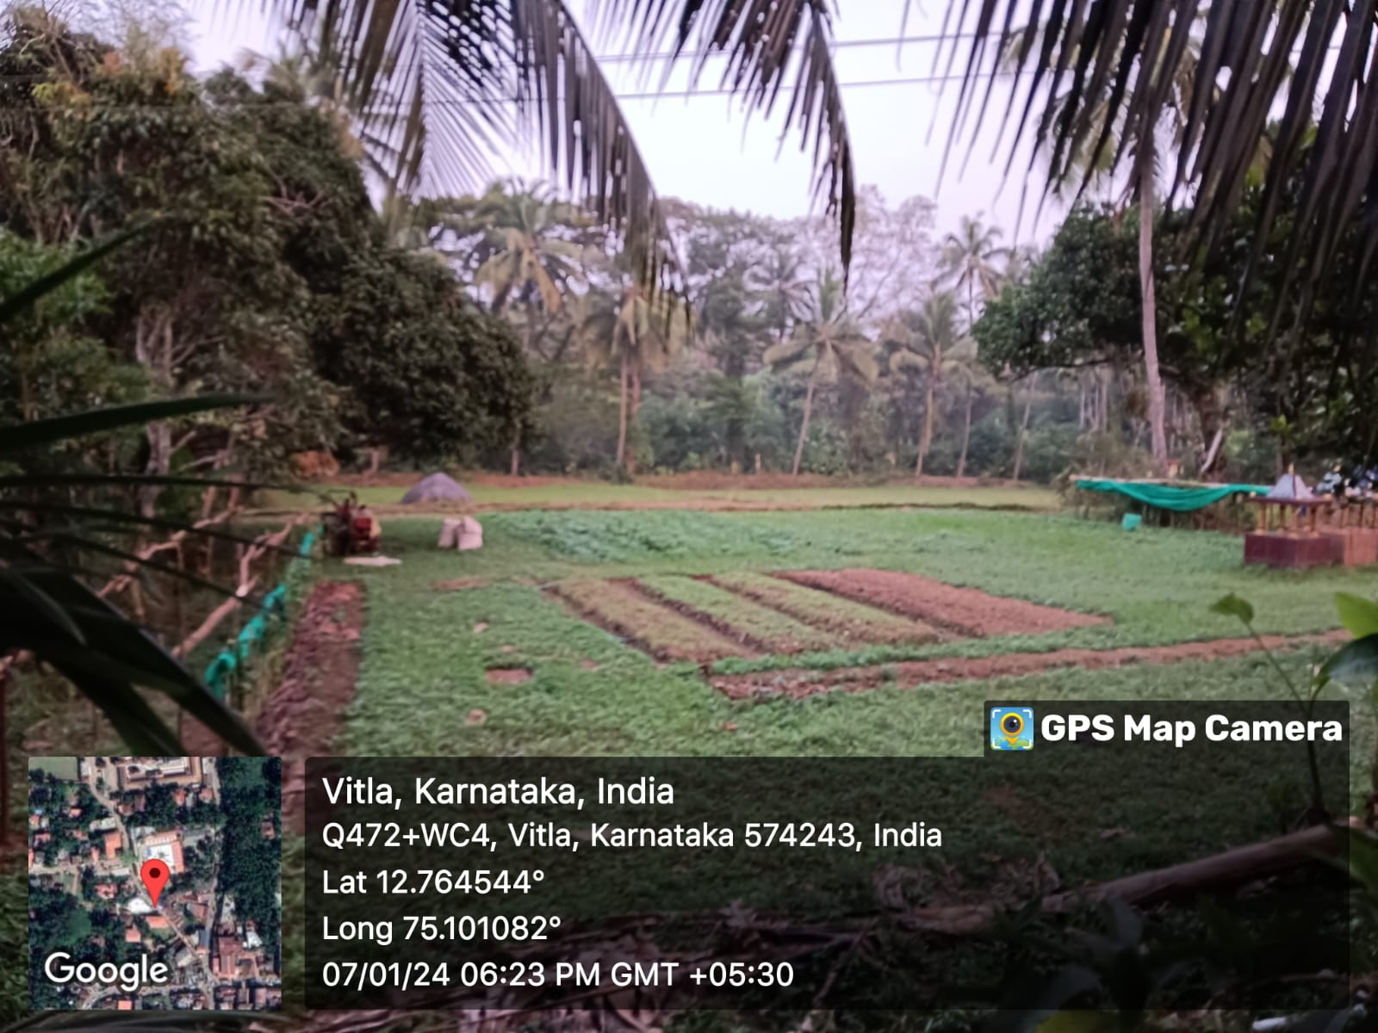

Slide 10
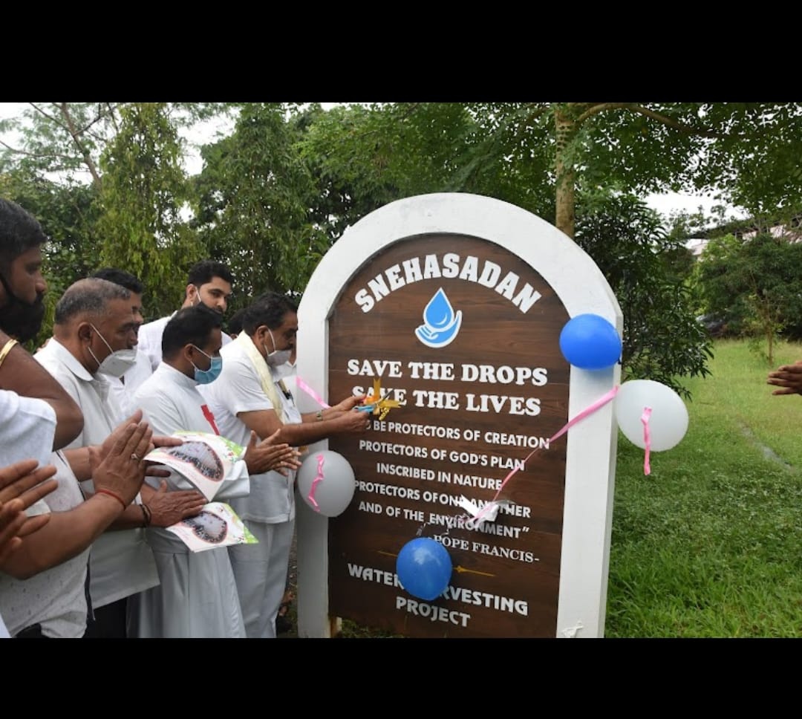
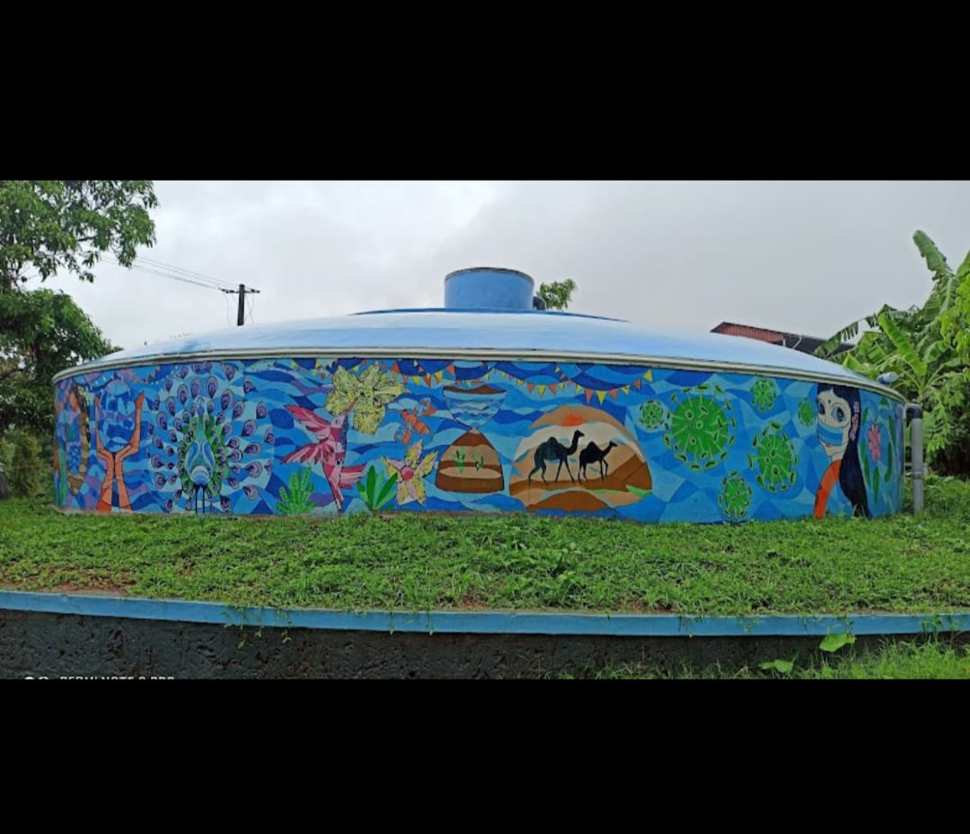
4.Water conservation:
Rain water harvesting of Snehasadan:
Method:
The rain water is collected directly from the roof of the building and directed to the huge sump as shown in the picture.
The rain water is stored and saved for the required times and when needed the rain water is filtered and used. The rain water collected serves the need of Snehasadan for about 6 months.

Slide 11

thank you

